Slide 1
Industrial Management IEM - 4127
Management Thoughts

Slide 2
Management
“Management is the process of designing and maintaining the environment in which individual work together in group, and efficiently and effectively accomplish the selected aim”
-Basic definition
“Art of getting things done through people”
- Mary Parker Follett.

Slide 3
Management Thoughts
(Ref: Organization and Management by R.D Agarwal; CHAPTER-2)
Management thought is classified in SIX “Schools of Management Theory”
The Classical School
The Scientific Management School
The Management Process School
The Bureaucracy Theory School
The Human Relations School
The Decision Theory School
The Management Science School
The Systems Theory School
The Contingency Theory School

Slide 4
The Classical School
The Classical School includes three theories. The theories are:
The Scientific Management Theory: Frederick W. Taylor aimed at making management as science based on “Well recognized, clearly defined and fixed principles instead of depending more or less on hazy ideas”
The Management Process Theory: Henri Fayol focused on a systematic understanding of the overall management process.
The Bureaucratic Theory: Max Weber has provided the point Bureaucratic of for the study of organization structure and function for over half a century

Slide 5
The Scientific Management School:
The use of measurement, experimentation, observation, analysis, rationality and reasoning used as the chief instrument for developing managerial systems.
The basic components of scientific management as proposed by the Taylor are:
Determination of Standard of Performance: Previously, worker or foreman have no idea about how much works need to be done in an hour or a day. An average number of work was used as a rule of thumb without and specific scientific calculation. But later on. Time and Motion study are introduced and analyzing the time and motion of each work done by the worker, the manager or supervisor now determine a standard of performance.
Functional Foremanship: Specialize worker will train the novice or intern worker. By doing this, intern worker will know the exact technique of the work and he can perform the work efficiently and productively without any hassle.

Slide 6
Responsibilities of Management: Managers should accept responsibility for planning, directing and organizing. Managers should perform these functions scientifically. Such as, Management should analyze all the operations and develop scientific methods of operations. Workers should be scientifically selected and trained.
Differential Piecework System of Wage Payment: The worker should receive a basic piece rate if the number of produced piece by the worker is below the pre determined production pieces. If the worker produced more than the standard production rate, then he/she need to be paid in a differential wage payment system so that he/she can remain motivated towards more production.
Mental Revolution: A co-operative work culture need to introduce to both the worker and the manager. It will involve a complete mental revolution in the attitudes of manager towards their fellowmen, workers. Without this complete mental revolution on both side this scientific management doesn’t exist.

Slide 7
2. The Management Process School:
The management process school regards management as the process of getting things done through people as individual and as members of work groups. It holds that management is a process which can best be understood by analyzing its functions.
Fayol identified 05 functions of Management:
Planning: Planning is the most crucial portion of the management as failure to plan causes weakness or disaster to business.
Organizing: It is regarded as the problem of organizing man and material.
Command: Command requires –
Thorough knowledge of personnel
Elimination of incompetent
Setting a good example
Development of Unity, royalty among people

Slide 8
d) Control: Control aimed at identifying deviations from standards and taking corrective actions. Control should not lead to duality of command by separating it from operation.
e) Co-ordination: Taylor suggested that weekly meeting of departmental head should be held in order to improve co-ordination.

Slide 9
III) The Bureaucratic Theory School:
Weber viewed Bureaucracy as “the most efficient form that could be used most effectively for complex organizations business, government, military.” It is characterized by:
Assignment of activities to individual as fixed duties
A hierarchy of authority and chain of command running throughout the organization, with a regulated system of appeal
Administration through well defined rules.
Decision making on objective and rational criteria so that all decisions are impersonal.
Employment and promotion based on demonstrated competence and training of officials.
Fixed salary based on status or rank rather than work performed or guaranteed pension or superannuation as security at old age.
Advantages: Precision, Speed, continuity, unity, discretion, strict subordination, reduction of friction and of material personnel cost are raised to optimal point.
Disadvantages: Lie in red tape, rigidity and neglect of human factor.

Slide 10
2. The Human Relations School:
Howthrone conduct an experiment on the human dimensions of the organizations. This school of thought termed as “neo-classical” rather than modern because it follows the theoretical form of classical theory and emphasis on the human dimensions of the management as a counter point against the impersonality of classical theory.
This theory lead to a new hypothesis : motivation to work, morale and productivity are related to the social relations among the workers, and between the workers and supervisor; and not to the physical condition of the work.
The researchers found that:
The worker perceived themselves as a work group.
The group has developed “norms” related to production as well as personal conduct among themselves and with the supervisors.
Dexterity and Intelligence tests showed that output isn’t related to either of them. The key to the rate of output was social membership in the clique.
These studies also revealed that an organization is more than a formal structure of position and authority responsibility relationships.

Slide 11
3. The Decision Theory School:
The decision theory school of management is led by Simon and looks upon the management process as a decision making process. According to this theory, the entire field of management can be studies from the study of the process of decision making. They have expanded their theoretical study through the study of
The decision
The Decision maker, and
The social and Psychological environment of the decision maker.
The decision maker start with the small area of decision making and then look at the entire field of the management through this keyhole.
Decision making is central to managing and whatever a manager do is done through making decisions. But the totality of managing is something more than decision making. The most important task of modern manager are:
1. Innovating, integrating organization with its external environment, and
2. Creation of an organization climate conductive to the optimum performance by its members.
Integrating the organization with the environment and integrating employees and their group with the organization require the art of managing and leadership.

Slide 12
4. The Management Science School:
The management scientists led by operation researchers and system analyst, see management as “a system of mathematical models and processes”. Since managing is a logical and rational process, it can be expressed in terms of mathematical relationships and models. The basic assumption of management science is, an organization is a system with its parts in interactional and interdependent relationships. These interactions and interdependencies can be expressed in terms of models and equations.
Management science has made significant contributions by applying the tools of mathematics to the solution of various complex problems of management. They have successfully build models in the area of:
Quality control, inventory control, production scheduling, machine loading, warehouse operations and resource allocation.

Slide 13
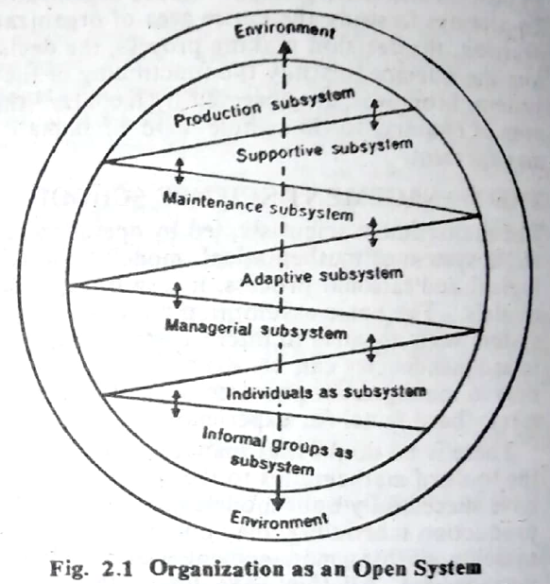
5. The System Theory School:
The system theorists has viewed organization as an open and organic system, which is composed of interacting and interdependent parts, called subsystems. (Showed in figure)

Slide 14
5. The System Theory School: (continue)
Organizations as an Open and Organic System
Organizations are open systems in that they are in continuous interaction relationship with other systems. These other systems comprise markets, suppliers, bankers, trade unions, governments, educational institutions and other similar enterprises, industry, economy etc., which constitutes its environment.
Organizations also organic systems or living systems as they must satisfy three conditions for their continuing survival:
First: A organization should be stable in the sense that its various parts should be in balance with one another.
Second: It should grow and mature like other entities.
Third: It should adapt to environmental changes. It is the constant adjustment in response to its changes in environments.

Slide 15
6. The Contingency Theory School:
The contingency theories aims at integrating theory in a practice in a systems framework. When an organization behaves in response to forces in its environment, its behavior is said to be contingent on these forces. Hence a contingency approach is an approach where the behavior of the of one subunit is dependent on its environmental relationship to other units or subunits that have some control over the consequences… desired by that subunit.
Thus, behavior on an organization is contingent on situations, and if the manager wants to change the behavior within an organization, he must attempt to change that part of its environment which is influencing it. Organization system is not a matter of managerial choice, but contingent upon its external environment.

